Slide 1
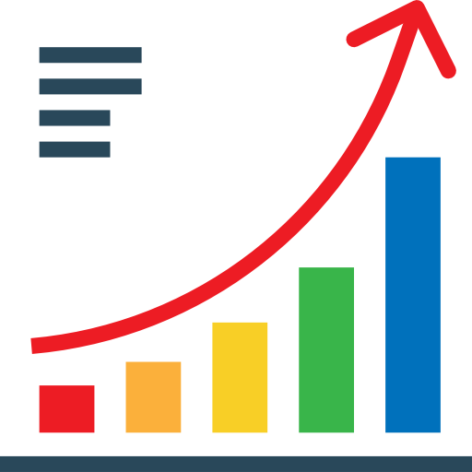
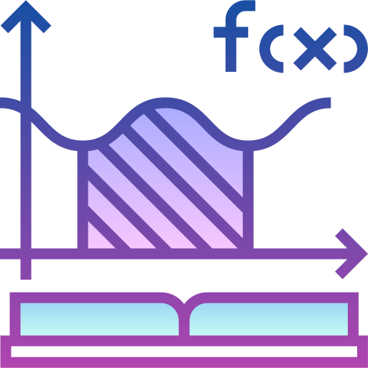
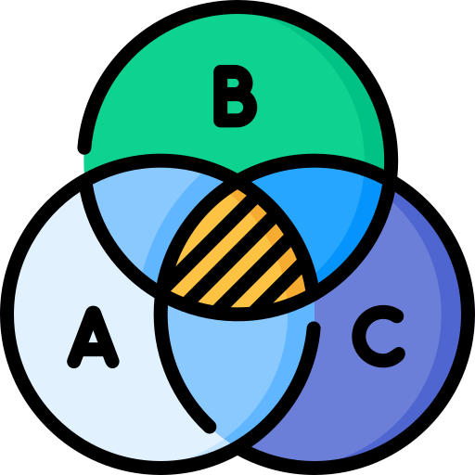
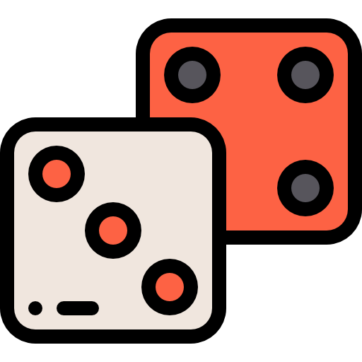
iGCSE Examination
Review: Data
Revision and Exam Practice
18
Review: Sets
3D Trigonometry
Sine and Cosine Formula
Review: Number
Review:
Shape and Space
17
10
11
12
13
14
15
16
9
Trigonometric Graphs
iGCSE Mock exam
Review: Algebra
Review: Graphs
Introduction to Calculus $\frac{dy}{dx} \int{}$
^{Conditional Probability}
Graphical Solutions to Quadratics
8
Functions $f(x)$
7
6
5
4
3
2
1
Histograms
1
2
Transformation of Graphs
Vectors $\vec{a}$
Cubic and Reciprocal Graphs
Y11
Perpendicular lines
Venn Diagrams
Circle theorems
22
18
19
20
21
16
End of year exam
Algebraic Fractions $\frac{x}{y}$
Probability
3D Shapes and Similarity
Recurring Decimals $\dot{x and bounds}$
Sequences $u_{n}$
Negative and rational powers
15
14
13
12
11
10
9
Compound Measures
Advanced Simultaneous Equations
Quadratic equations
8
Proportion $∝$
Review: Y9 Shapes and Space
Review: Y9 Percentages
Surds $\sqrt{2}$
Y10
1
2
3
5
6
7
4
Indices $x^{n}$
Review: Y9 Graphs
Review: Y9 Equations
Review: Y9 Quadratics
Department Intent

Slide 2
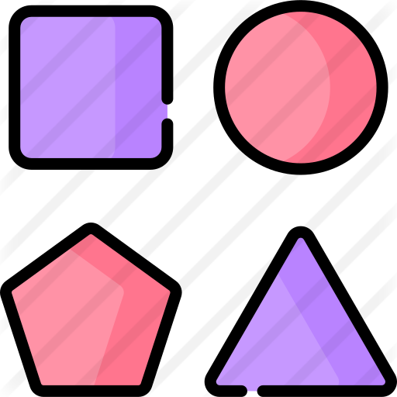
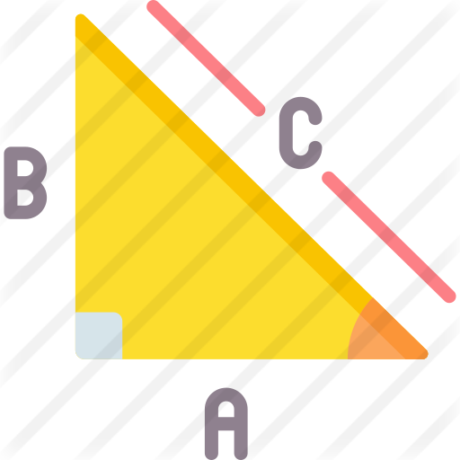
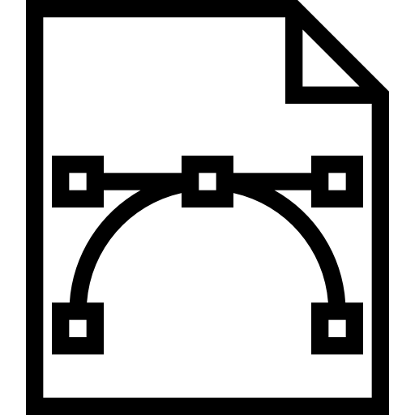
Surds $√$
Solving Quadratics by factorising
Rearranging Formulae
Compound and Inverse Percentages $\%$
Trigonometry $\sin{x, cosx,tanx}$
20
19
18
17
16
15
14
13
End of year exam
Probability
Quadratic Graphs
Expanding brackets
Simultaneous Equations
Expressions and Equations
Straight Line Graphs
$$y=mx+c$$
Sets
Equations with Powers
Pythagoras and Circle Theorems
12
2
3
4
5
6
7
8
9
10
11
1
BIDMAS
2D Shapes
Standard Form
Straight Line Graphs 2
$$y=mx+c$$
Data
HCF/LCM and Ratio
Y9
Graphs
Probability
Percentages
11
10
9
8
7
End of year exam
Scale Drawings and Measurements
Constructions and Loci
6
1
2
Working with Powers
Real Life Graphs
Transformations
5
1
2
3
4
Y8
Factors and Powers
2D Shapes and 3D Solids
Sequences and Graphs $T_{n}$
Multiplicative Reasoning
Equations
Decimals
13
12
11
10
9
8
7
6
End of Year Exam
Perimeter, Area and Volume
Order of
Operations
Constructions
Transition day
Number Skills
Fractions
Y6
Y7
5
S
T
1
2
3
4
PTM
Analysing and displaying data
Equations, Functions and Formulae
Angles and Shapes
Department Intent

